Slide 1
蘭花種類辨識及分類
RE6103013 卞哲琛
RE6101029 蔣允中

Slide 2
Outline
Introduction
Task & Dataset
Challenges
Data Preprocessing
Method
Experimental Outcome
Conclusion
Reference

Slide 3
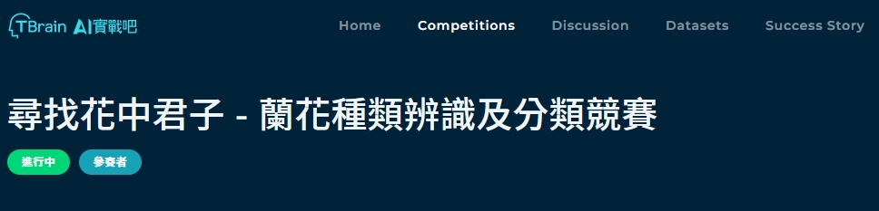
Introduction

Slide 4
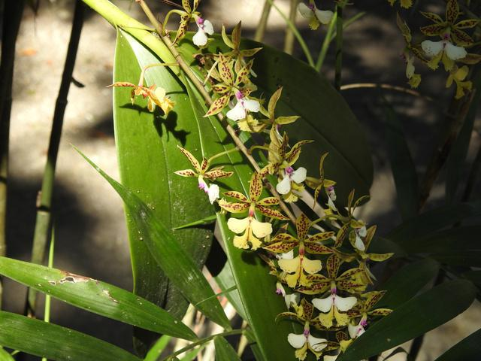


Slide 5
Task & Dataset

Slide 6
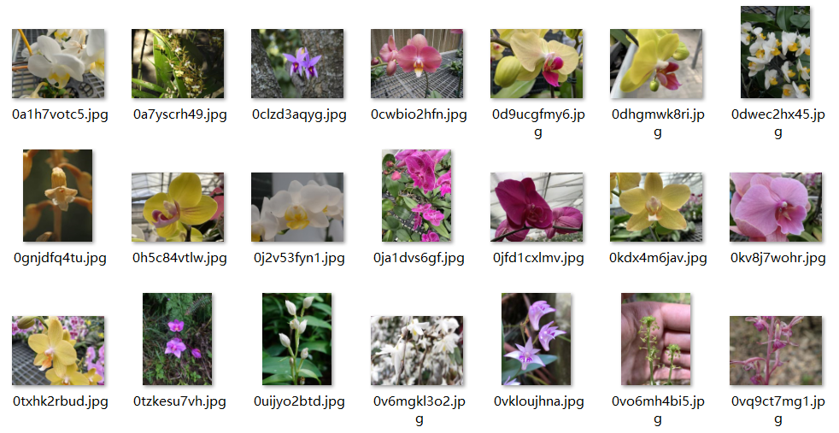
Task
將2191張未分類的蘭花圖片通過給定的label檔案分類成219個種類。
images
model
categories
labels
Ex:
ResNet, Swim transformer,
EfficientNetB4, ViT, etc.
Datasets
- 2,190 images
- 219 classes (0~218)
- 10 images each class
- image format : 640x480(vert&hori) ,RGB
- 1 label.csv
Train : Val = 80% : 20%

Slide 7
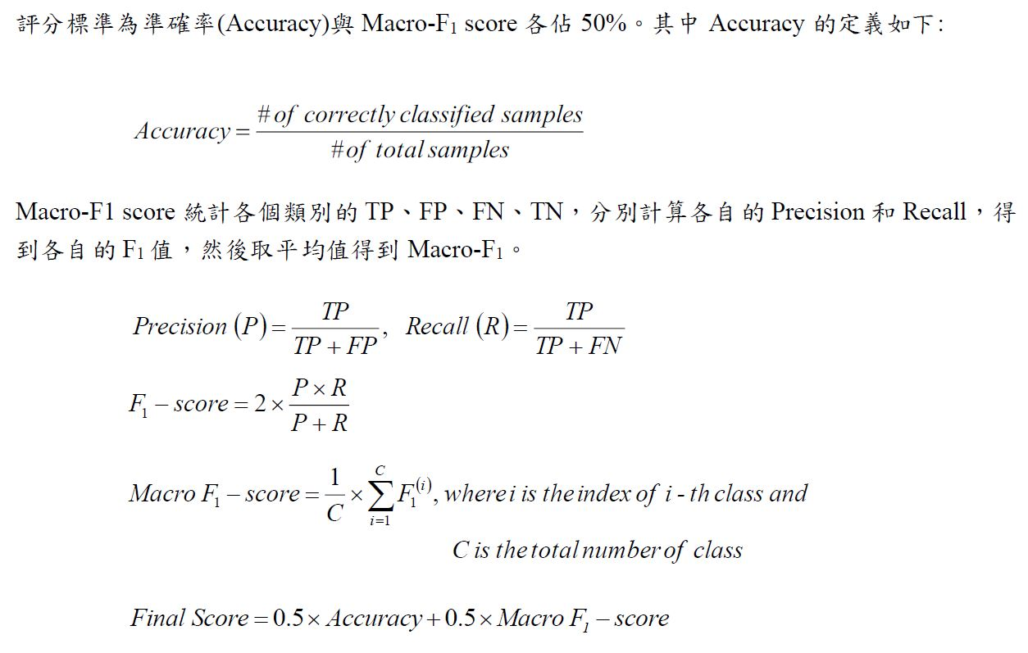
Schedule
Criteria

Slide 8
Challenges

Slide 9


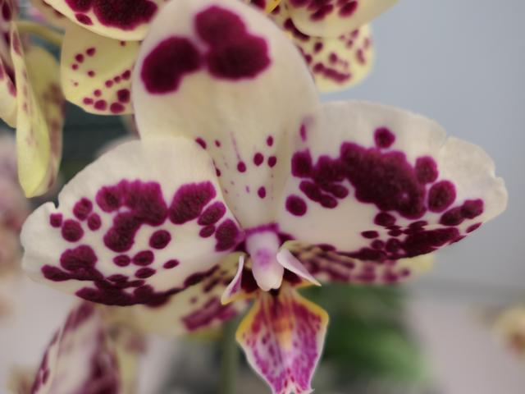
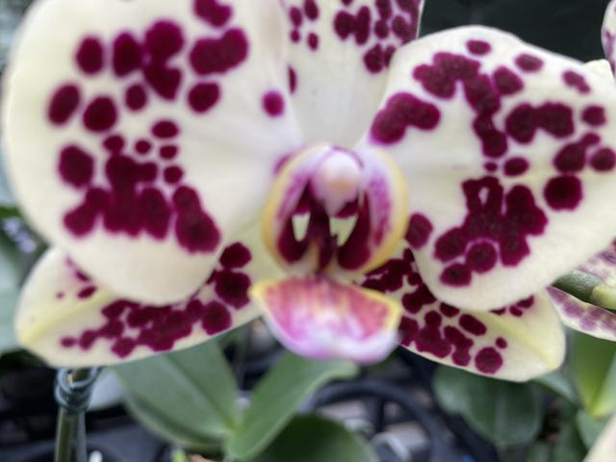
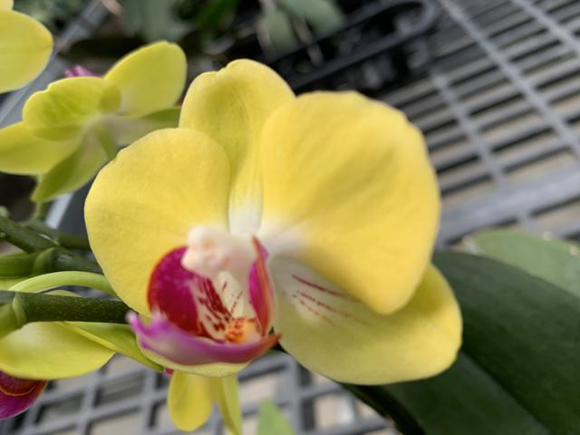
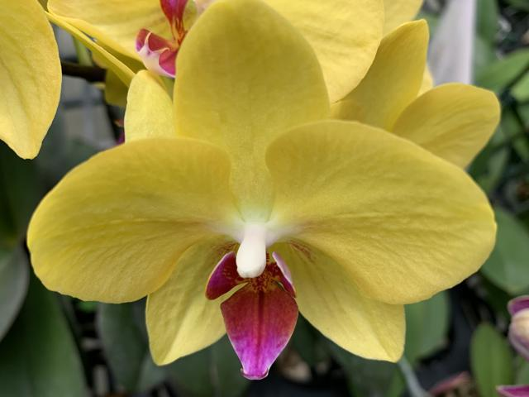
Challenge 1: more categories, less sample
X10
X219
Challenge 2: high similarity but different labels
(category 8)
(category 6)
Group 1
(category 13)
(category 19)
Group 2

Slide 10
Data
Preprocessing

Slide 11
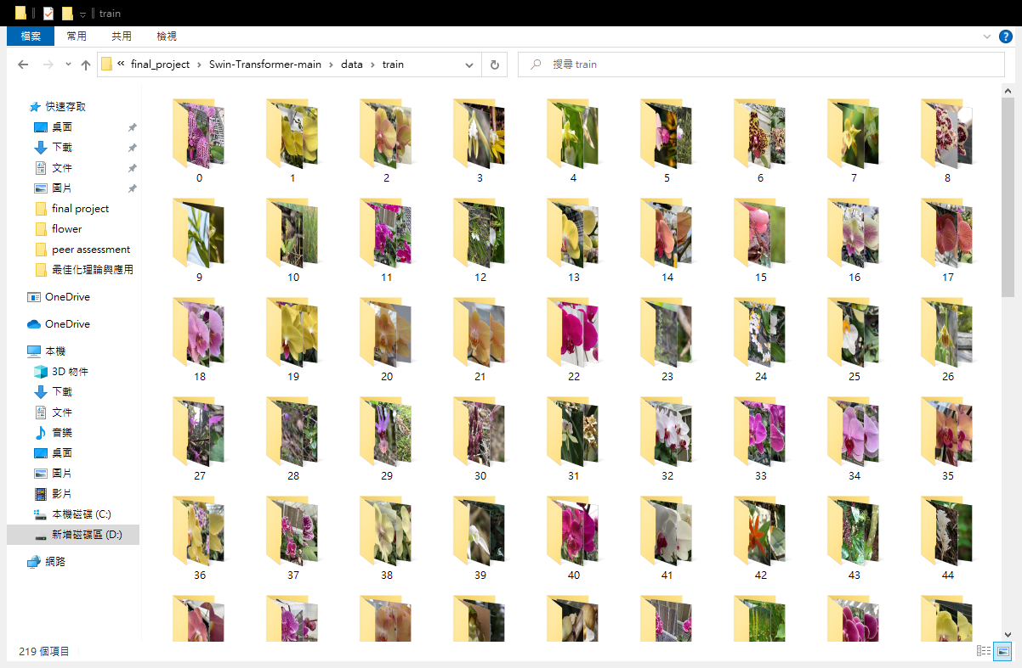
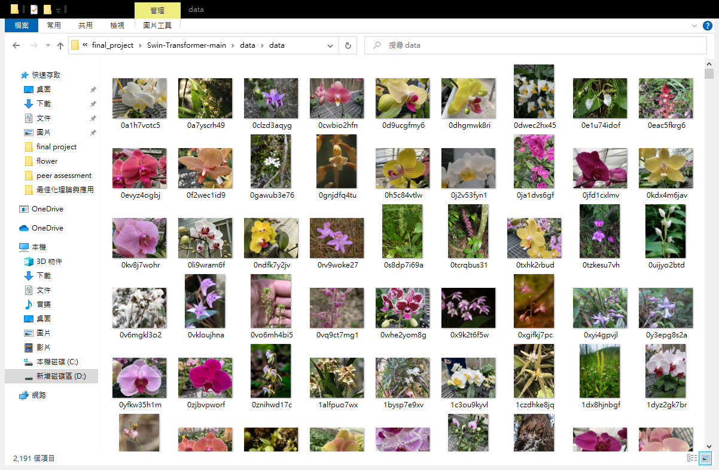
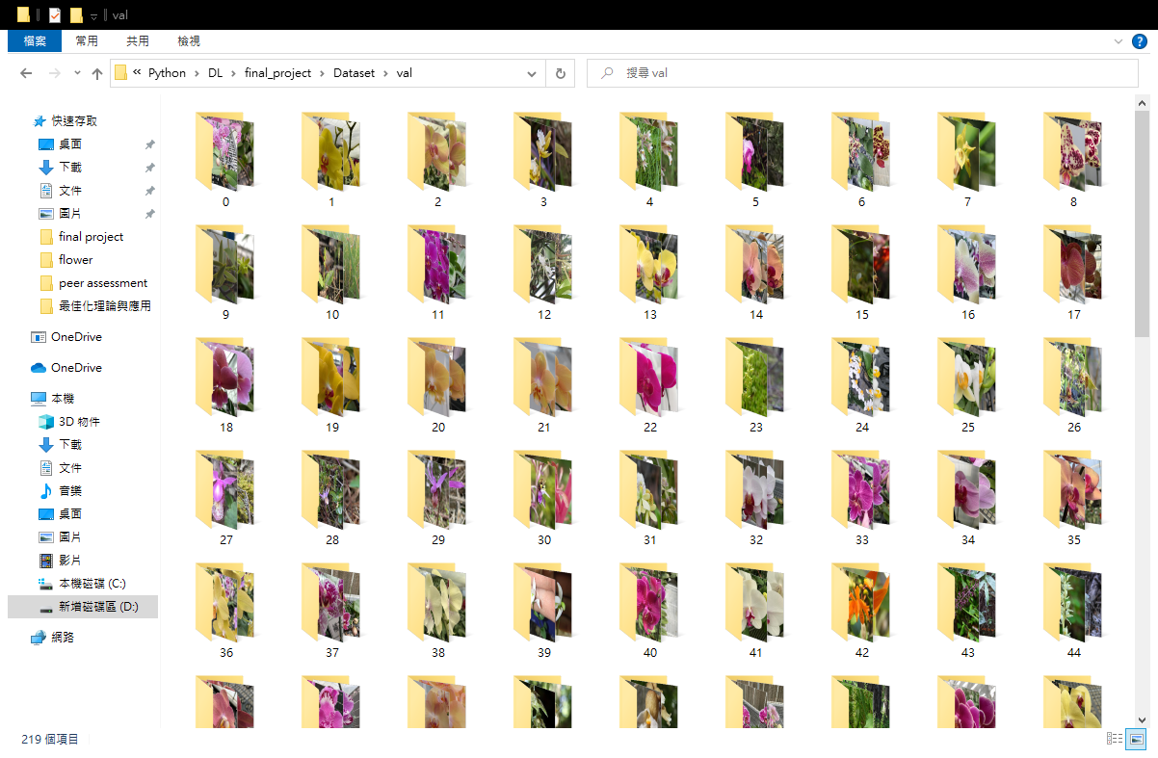

train: 8
Step 1: regroup the figures
➔
val: 2

Slide 12

Step 2: resize the figure
64X64
640X480
128X128

Slide 13
Step 3: OHE on labels
 | 0 | 1 | 2 | … | 217 | 218
pic1 | 1 | 0 | 0 | … | 0 | 0
pic2 | 1 | 0 | 0 | … | 0 | 0
pic3 | 0 | 1 | 0 | … | 0 | 0
pic4 | 0 | 0 | 1 | … | 0 | 0
… | … | … | … | … | … | …
… | … | … | … | … | … | …
Training label
[0 , 0 , 0 , 0 , 0 , 0 , 0 , 1 , 1 , 1 ,
1 , 1 , 1 , 1 , 2 , 2 , 2 , 2 , 2 ,2 , 2
, 3 , 3 , 3 , 3 , 3 , 3 , 3 , 4 , 4 , 4 ,
4 , 4 ,4 , 4 , 5 , 5 , 5 , 5 , 5 , 5 , 5
, 6 , 6 , 6 , 6 , 6 , 6 , 6 , 7 , 7 , 7
………………………………………
………………………………………
………………………………………
218 , 218 , 218 , 218 , 218 , 218]
OHE
➔

Slide 14
Method

Slide 15
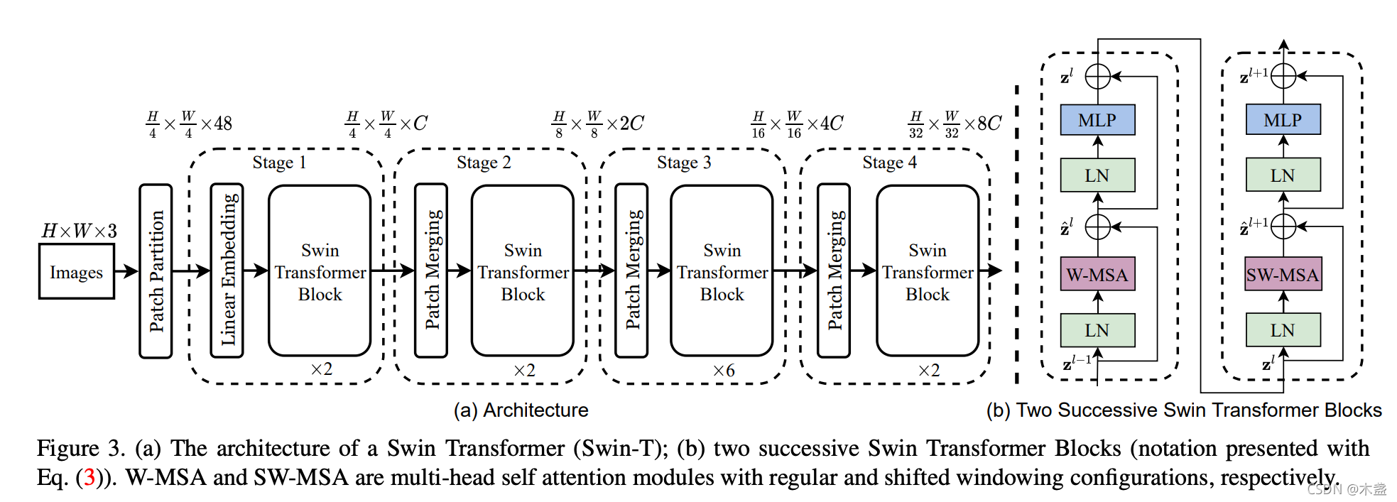
Method 1
Swin Transformer: Hierarchical Vision Transformer using Shifted Windows

Slide 16
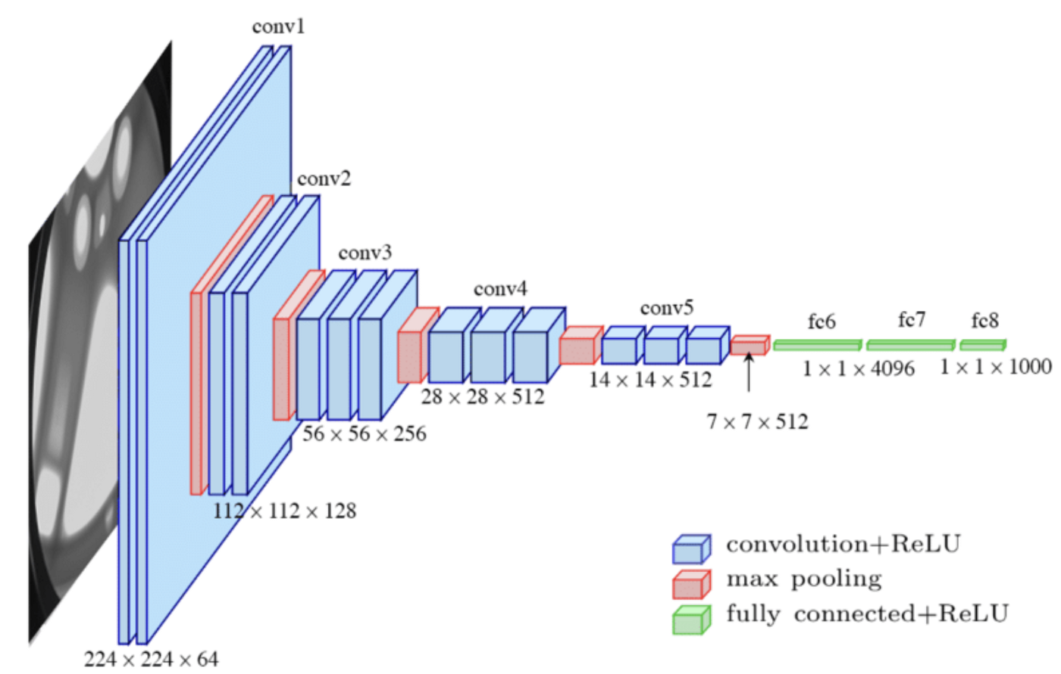
Method 2
VGG: Very Deep Convolutional Networks for Large-Scale Image Recognition
_________________________________________________________________
Layer (type) Output Shape Param #
==============================================================
input_4 (InputLayer) [(None, 256, 256, 3)] 0
lambda_3 (Lambda) (None, 256, 256, 3) 0
block1_conv1 (Conv2D) (None, 256, 256, 64) 1792
block1_conv2 (Conv2D) (None, 256, 256, 64) 36928
block1_pool (MaxPooling2D) (None, 128, 128, 64) 0
block2_conv1 (Conv2D) (None, 128, 128, 128) 73856
block2_conv2 (Conv2D) (None, 128, 128, 128) 147584
block2_pool (MaxPooling2D) (None, 64, 64, 128) 0
block3_conv1 (Conv2D) (None, 64, 64, 256) 295168
block3_conv2 (Conv2D) (None, 64, 64, 256) 590080
block3_conv3 (Conv2D) (None, 64, 64, 256) 590080
block3_pool (MaxPooling2D) (None, 32, 32, 256) 0
block4_conv1 (Conv2D) (None, 32, 32, 512) 1180160
block4_conv2 (Conv2D) (None, 32, 32, 512) 2359808
block4_conv3 (Conv2D) (None, 32, 32, 512) 2359808
block4_pool (MaxPooling2D) (None, 16, 16, 512) 0
block5_conv1 (Conv2D) (None, 16, 16, 512) 2359808
block5_conv2 (Conv2D) (None, 16, 16, 512) 2359808
block5_conv3 (Conv2D) (None, 16, 16, 512) 2359808
block5_pool (MaxPooling2D) (None, 8, 8, 512) 0
global_average_pooling2d_2 (None, 512) 0
(GlobalAveragePooling2D)
fc1 (Dense) (None, 1024) 525312
dropout_3 (Dropout) (None, 1024) 0
predictions (Dense) (None, 219) 224475
==============================================================
Total params: 15,464,475
Trainable params: 15,464,475
Non-trainable params: 0
_________________________________________________________________

Slide 17
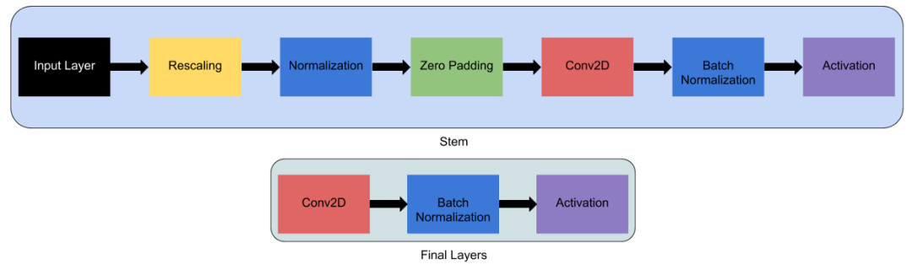
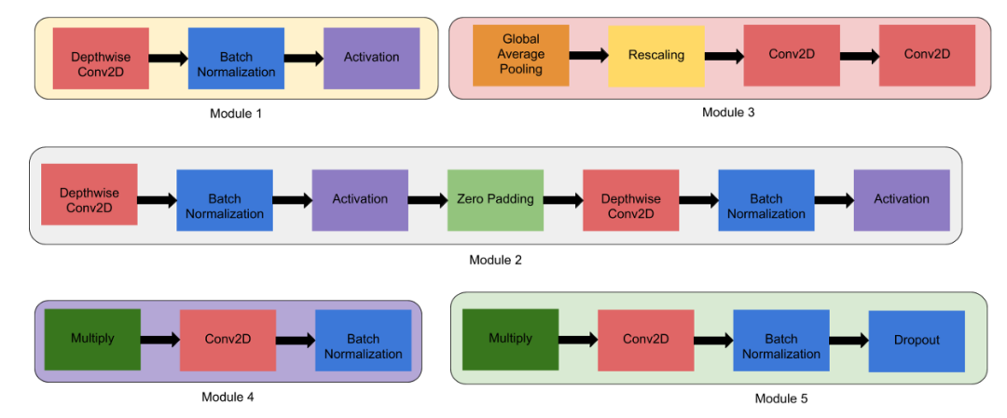
Method 3
EfficientNet: Rethinking Model Scaling for Convolutional Neural Networks
Total Param: 19,734,330

Slide 18
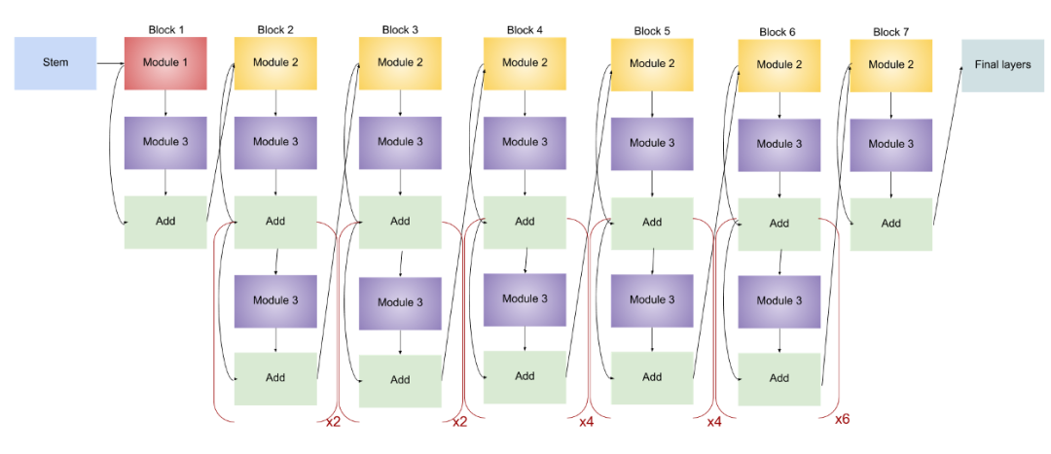
Method 3
EfficientNet: Rethinking Model Scaling for Convolutional Neural Networks
Total Param: 19,734,330

Slide 19
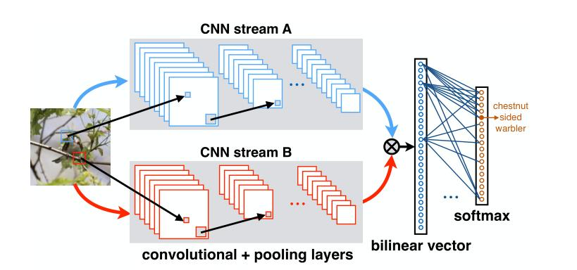
Method 4
Bilinear CNNs for Fine-grained Visual Recognition
➔ Replace CNNs with VGG-16 models, then we construct Bilinear VGG-16

Slide 20
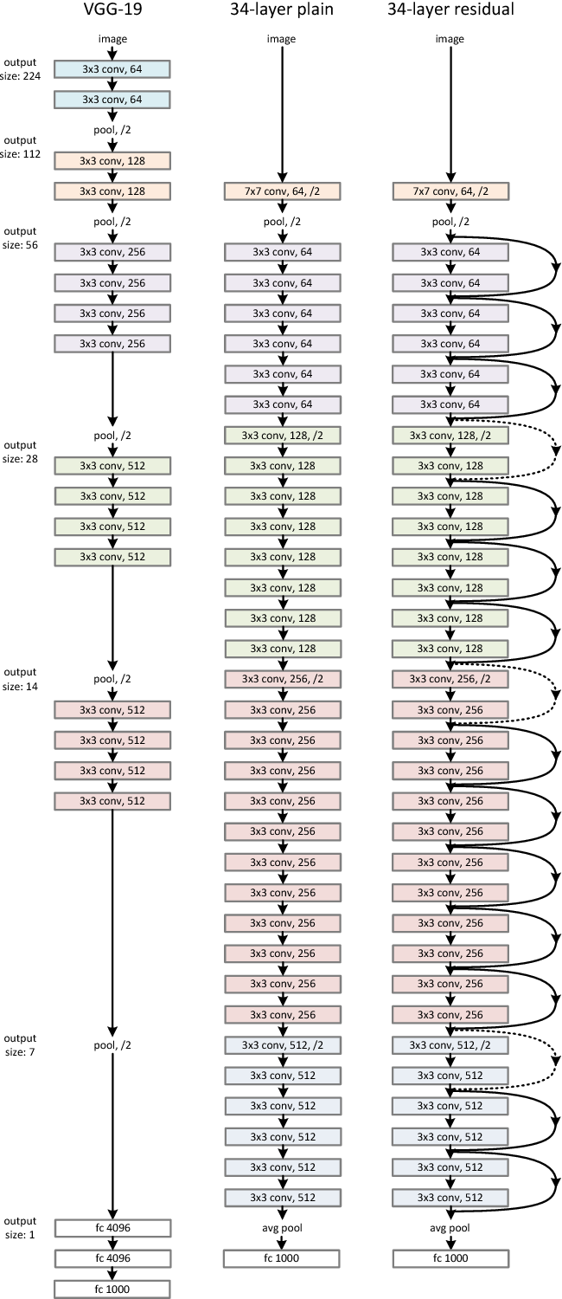
Method 5: ResNet
input
Conv2d
BN2d
Relu
Conv2d_1
BN2d_1
Relu
Conv2d_2
- Stage 1: Input section
- Stage 2: 3 Layers
- Stage 3: Output section
BN2d_2
Relu
Conv2d_3
BN2d_3
Relu
Conv2d_4
BN2d_4
Relu
Conv2d_5
BN2d_5
Relu
Conv2d_6
BN2d_6
SoftMax
Average_pooling
flatten
dense
classifier

Slide 21
Experiment Outcome

Slide 22
Experiment Outcome
 | Val ACC@1 | Val ACC@5 | Avg Loss | Pre-trained | epoch
Swin Transformer | 0.88 | 0.98 | 2.1980 | swin_tiny_patch4_window7_224 | 300
 | Train ACC | Train Loss | Val ACC | Val Loss | Stop epoch
VGG16-resize64*64 | 0.81 | 0.76 | 0.21 | 4.33 | 32
VGG16-resize128*128 | 0.97 | 0.16 | 0.37 | 2.91 | 49
Bilinear VGG16-resize64*64 | 1 | 0.04 | 0.28 | 2.95 | 81
Bilinear VGG16-resize128*128 | 1 | 0.01 | 0.42 | 2.33 | 100
EfficientNetB4-resize64*64 | 0.81 | 0.76 | 0.21 | 4.33 | 48
EfficientNetB4-resize128*128 | 0.98 | 0.2 | 0.37 | 2.7 | 40
ResNet | 0.91 | 0.53 | 0.42 | 3.89 | 49

Slide 23
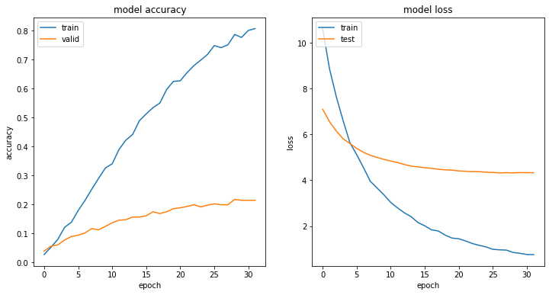
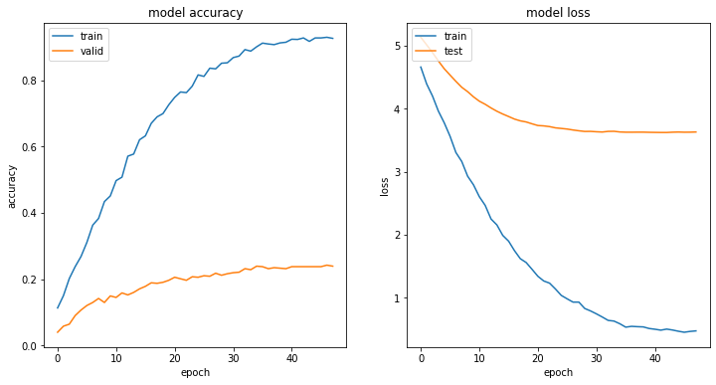
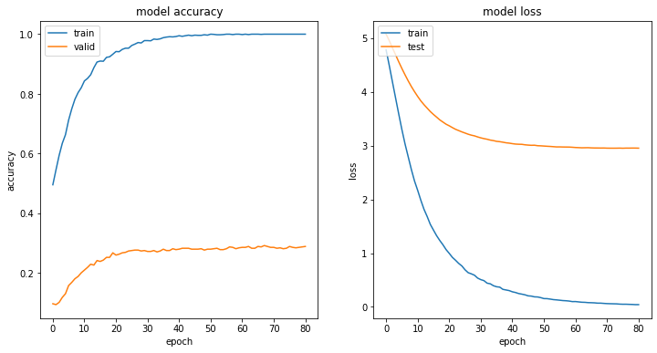
VGG16
Train History
SIZE: 64X64
Train:Val = 8:2
ACC converge at 20 epoch
EfficientNet-B4
Bilinear VGG-16

Slide 24
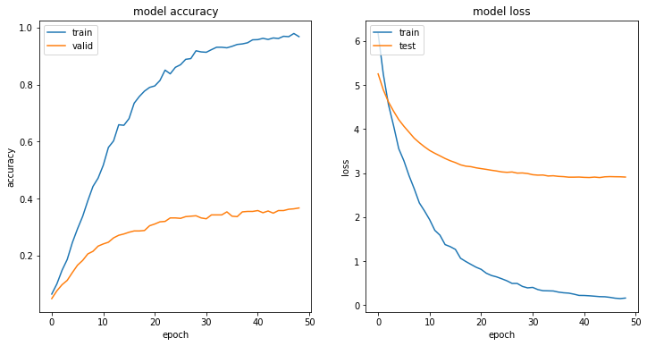
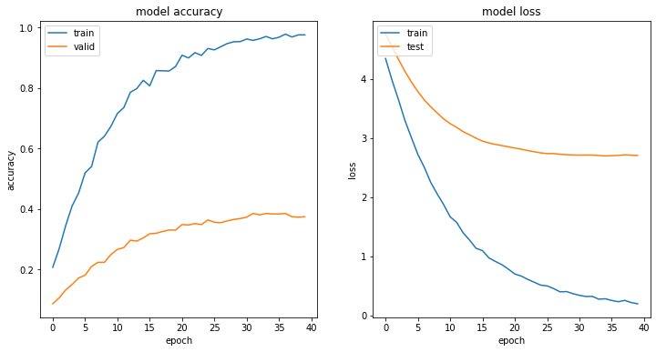
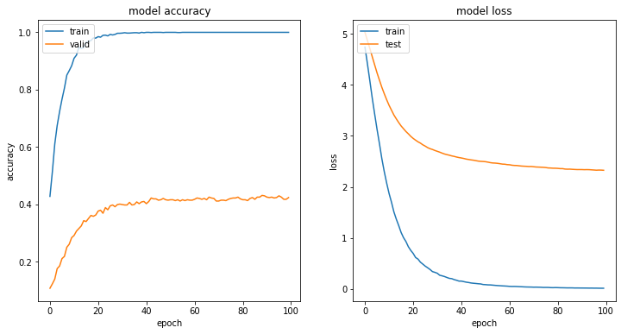
VGG16
Train History
SIZE: 128X128
Train:Val = 8:2
ACC converge at 15 epoch
➔ Both ACC & Loss are greater than 64X64
EfficientNet-B4
Bilinear VGG-16

Slide 25
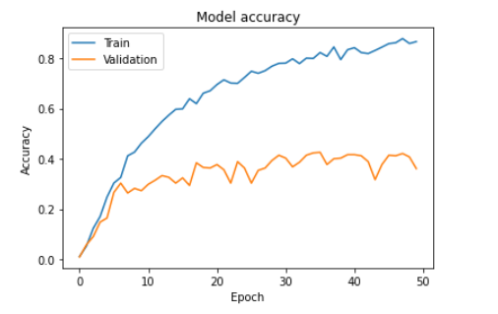
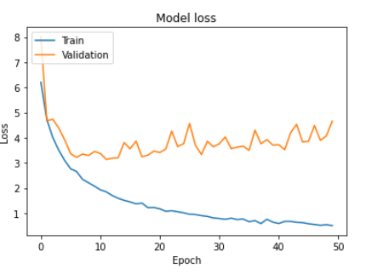
ResNet Train History
Data augmentation:
Rotation_range
randomly flip images
SIZE: 224X224
Train:Val = 8:2
ACC converge at 10 epoch

Slide 26
Conclusion
1.VGG based model seems not perform well on this dataset.
2.EfficientNet with complex layer didn’t perform greater than other models.
3.If we do more augmentation, VGG16, Bilinear-VGG16,
EfficientNet-B4 will have better performance according to our experimental result.
4.We guess that all models have overfitting because the lack of images in each class.
5.Swin Transformer has the best score, which is up to 87% on validation set.
6.Traditional model like VGG-16 doesn’t work better on data which only have few images in a class.

Slide 27
References
Tutorial on Keras flow_from_dataframe
https://vijayabhaskar96.medium.com/tutorial-on-keras-flowfrom-dataframe-1fd4493d237c
Trains a ResNet on the CIFAR10 dataset
https://keras.io/zh/examples/cifar10_resnet/
Self-Promoted Supervision for Few-Shot Transformer
https://arxiv.org/abs/2203.07057
Swin Transformer: Hierarchical Vision Transformer using ShiftedWindows
https://arxiv.org/abs/2103.14030
ResNet’s residual learning
https://medium.com/@hupinwei/%E6%B7%B1%E5%BA%A6%E5%AD%B8%E7%BF%92-resnet%E4%B9%8B%E6%AE%98%E5%B7%AE%E5%AD%B8%E7%BF%92-f3ac36701b2f

